Slide 1

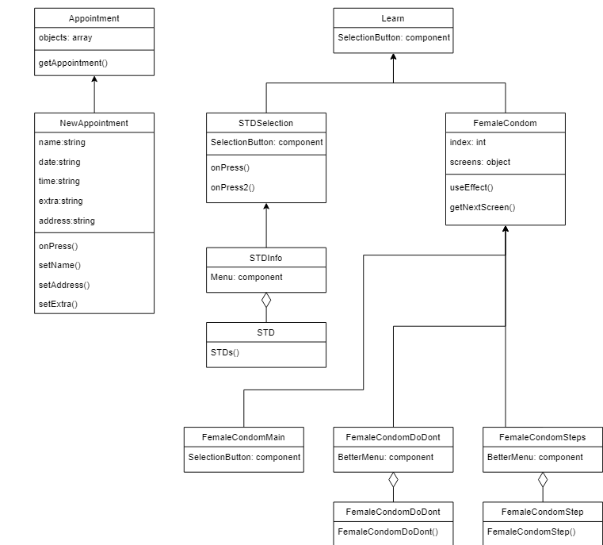






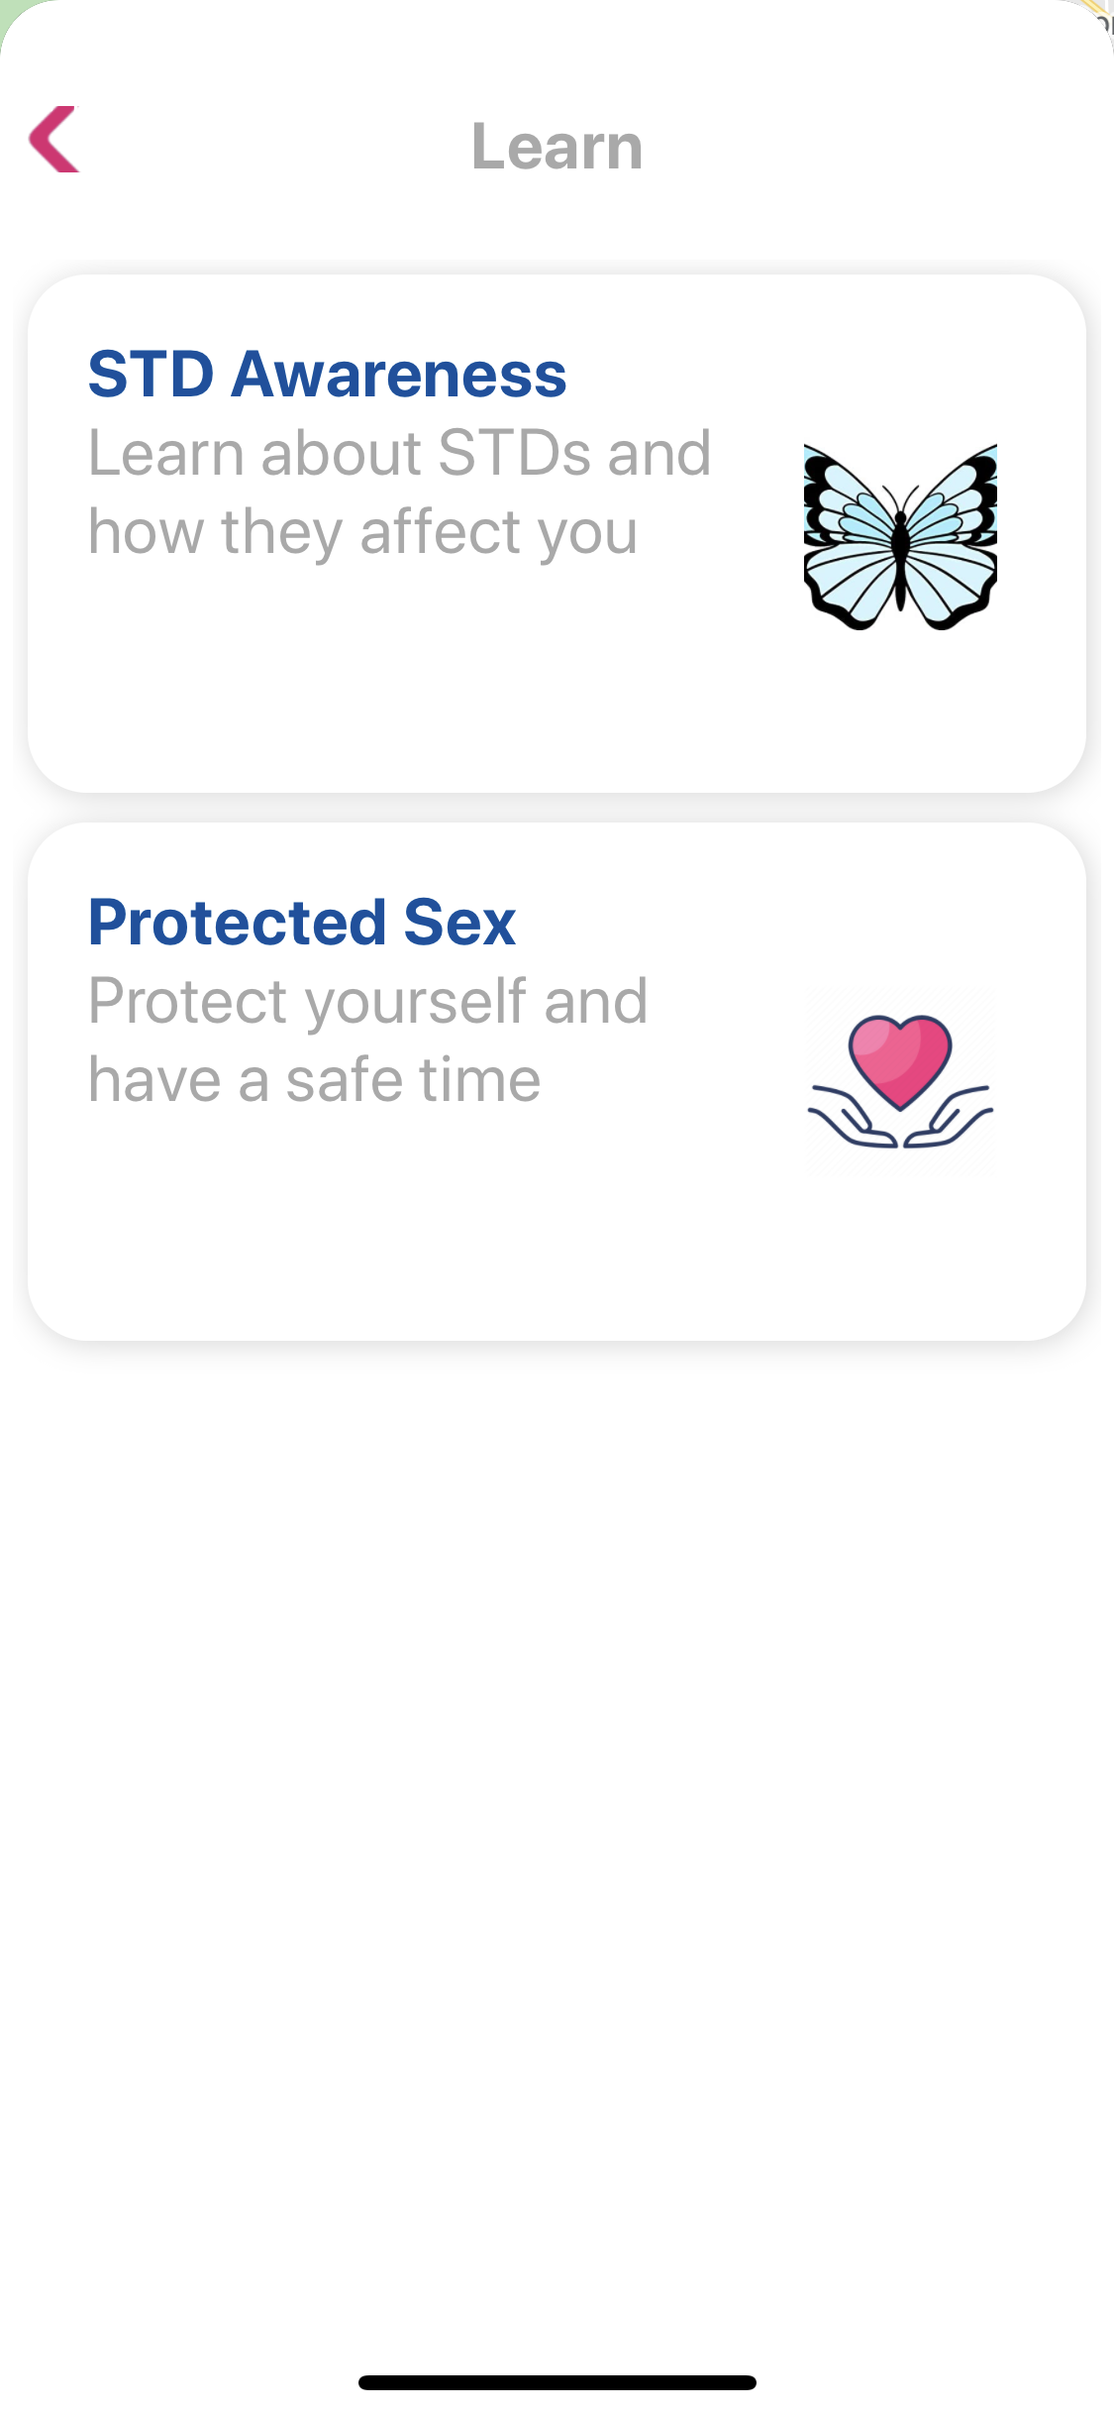
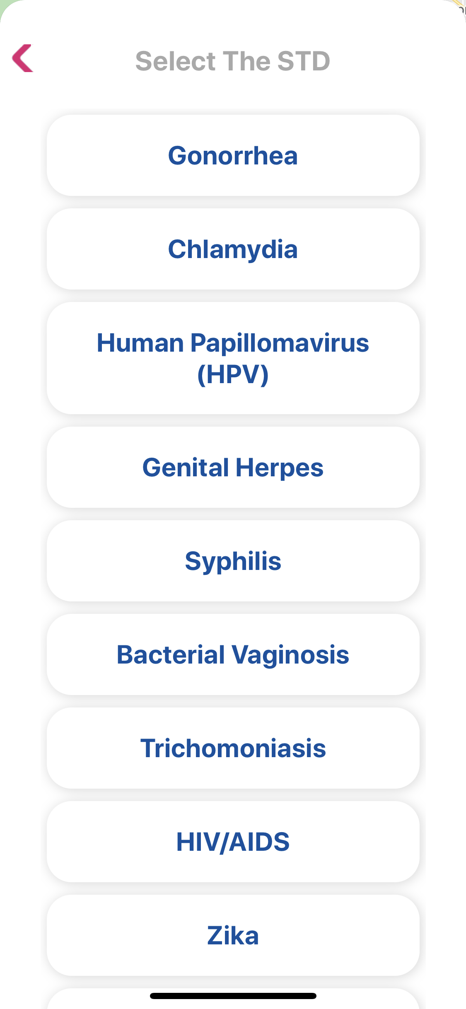
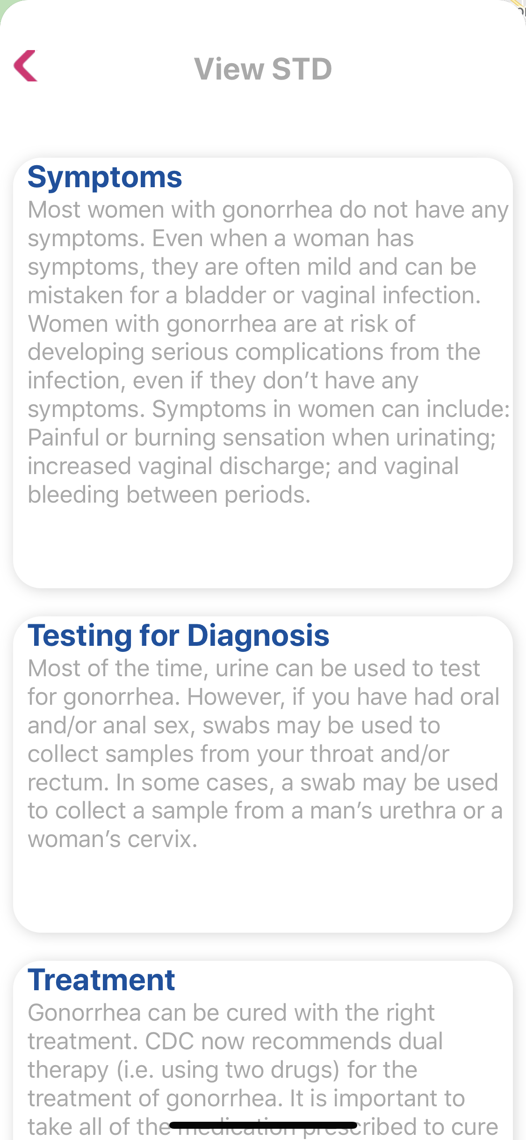
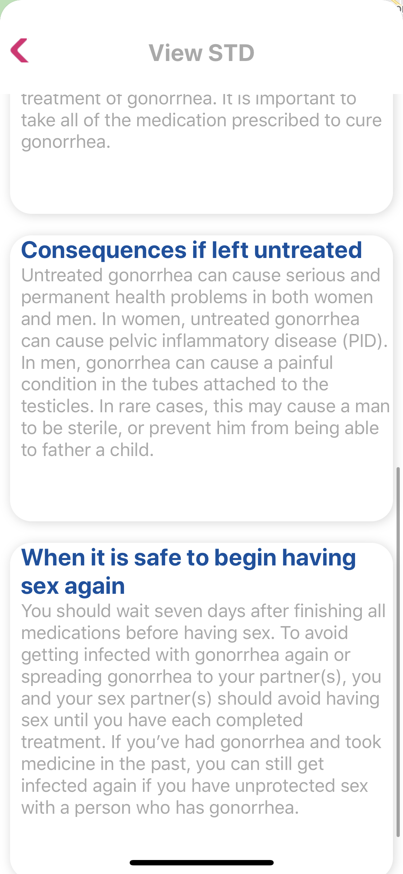
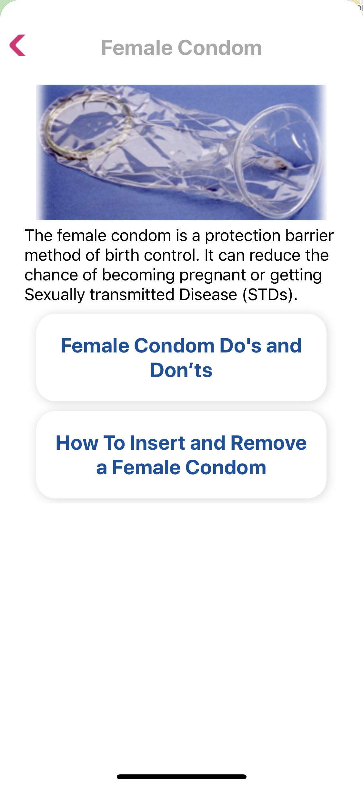
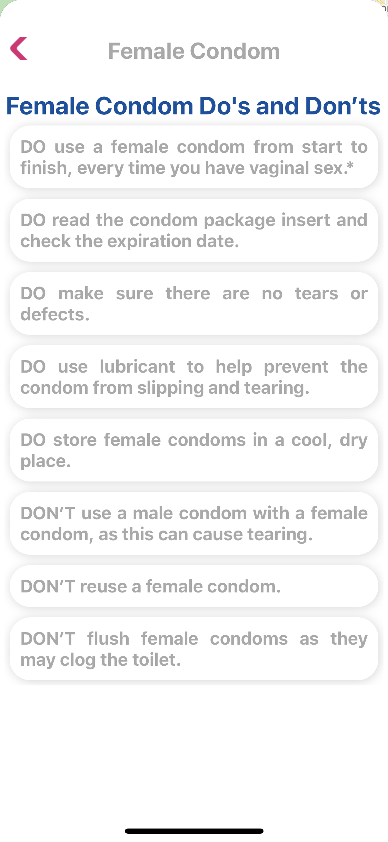
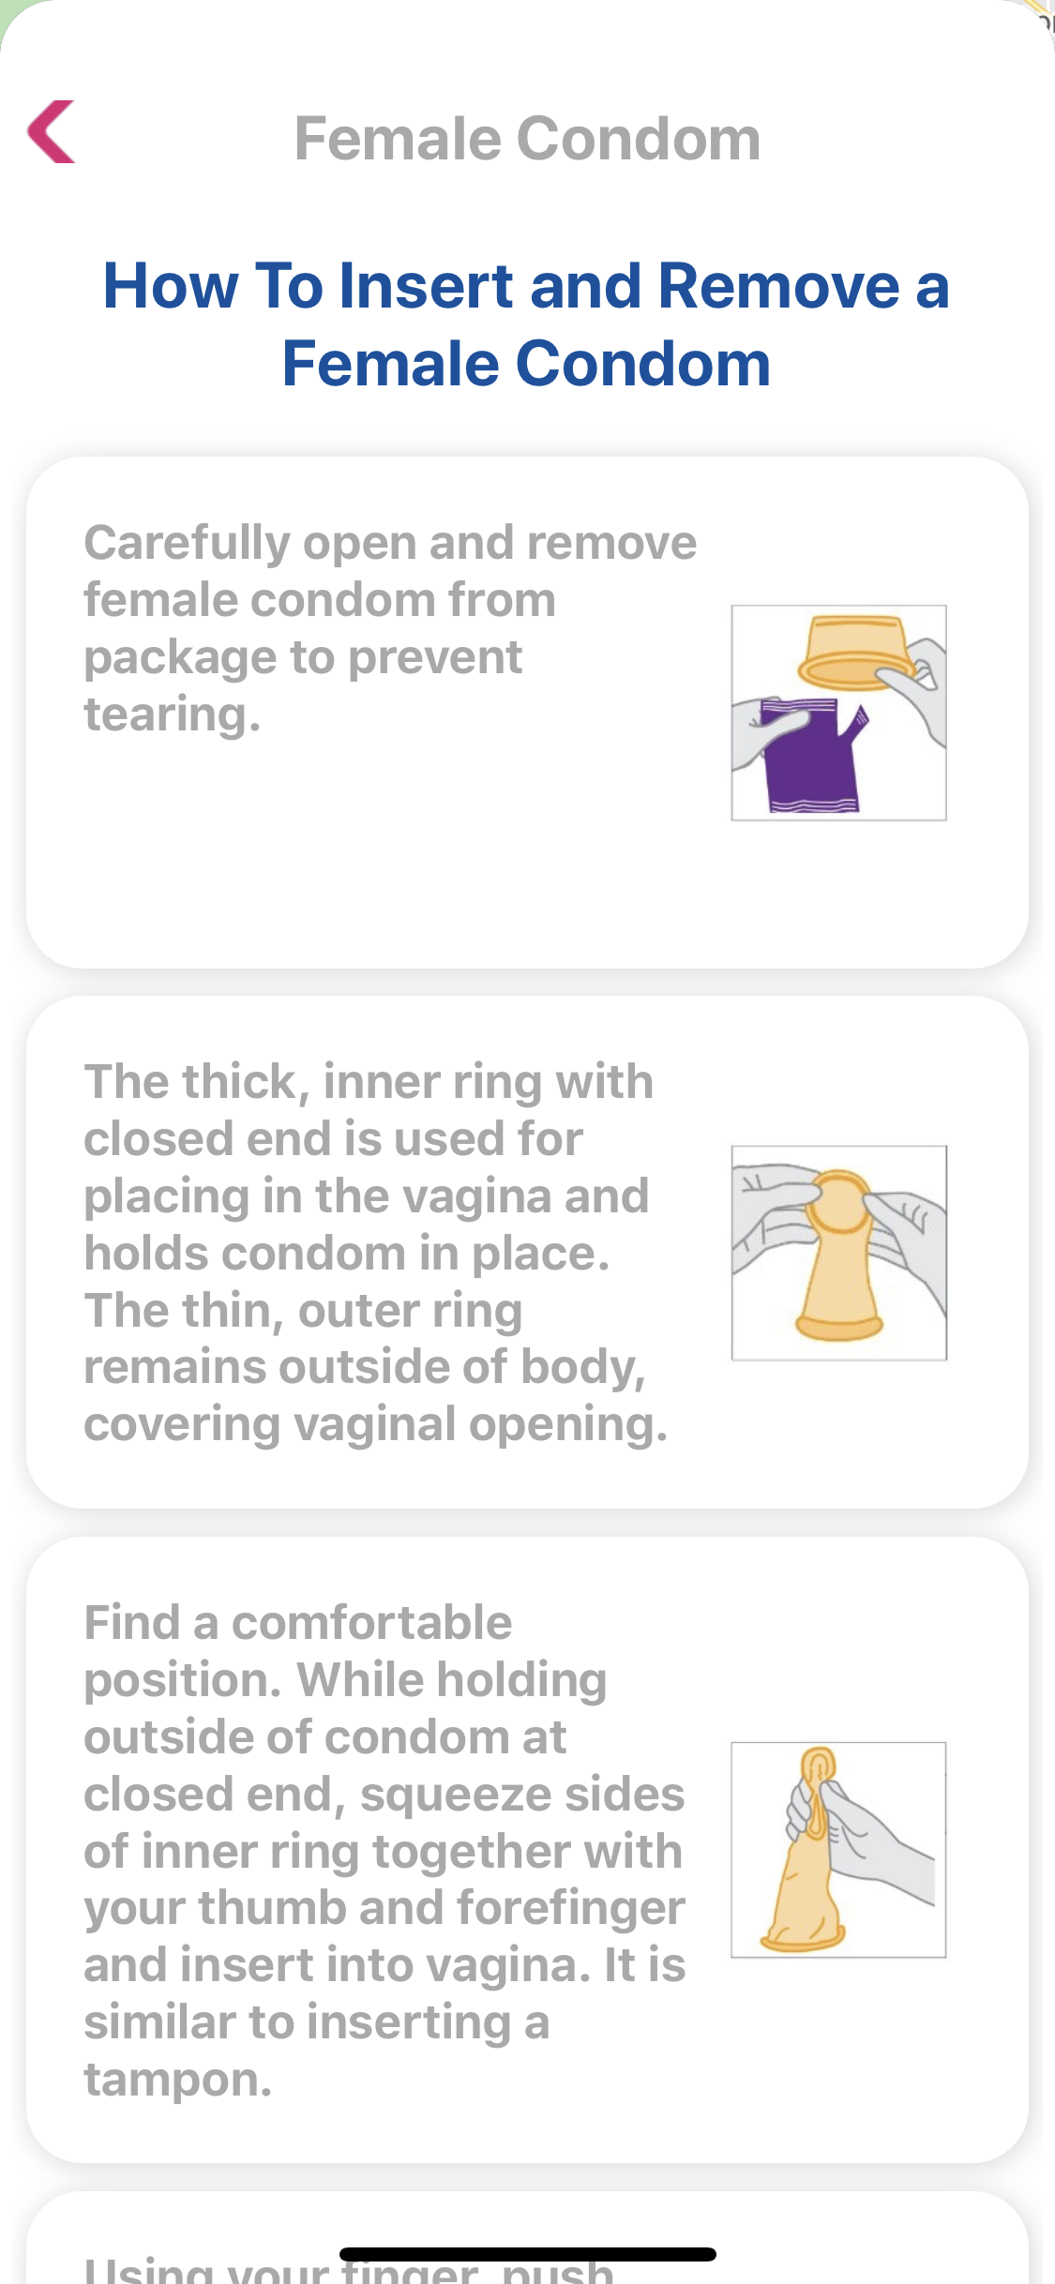
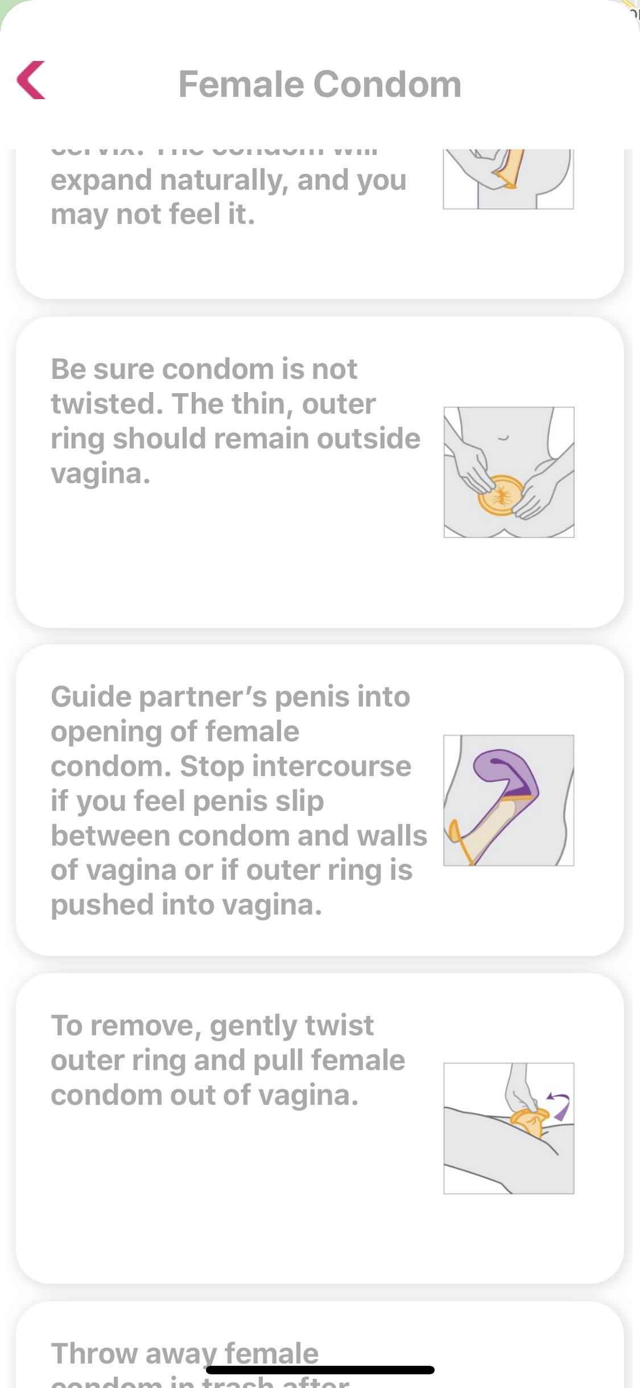
School of Computing & Information Sciences
Summer 2020 Senior Design Project
Keeping Moms & Infants Healthy V3
Students: Amin Sheikhnia
Mentor: Jean Hannan
Instructor: Dr. Masoud Sadjadi, Florida International University
`
Problem
Current System
Requirements
Mothers of low-income households maybe aware of the dangers of STDs, but do not have the knowledge of the preventive and post measures necessary to keep themselves safe. These mothers need to have the knowledge to protect themselves from any type of STD they may have come into contact with.
There was no section within the application that provided information to the mother about how they should protect themselves.
The current system was devoid of information other than the locations of clinics in the area.
Lacked many features that would enrich the users experience while using the application.
Creating a feature that shows information about STDs.
Creating a feature that shows information about female condom.
Depiction of the information in a visually appealing way so that the user does not get intimidated by the information shown.
Give the user enough information as not to overwhelm them, but to inform them on said matters.
System Design
Object Design
Implementation
A visually appealing mobile application that holds important information necessary for a mother to have. Giving the mother ample information that is concise and easy to follow, allowing for the mothers to make informed decisions based on the information provided.
Verification
Screenshots
Summary
Case ID | STD
Purpose | To add information about STDs.
Preconditions | The user desires the knowledge regarding STDs.
Expected results | The user is able to see information about STDs.
Case ID | Female Condom
Purpose | To add information about the female condom.
Preconditions | The user desires the knowledge regarding female condoms.
Expected results | The user is able to see information about the female condom.
The information provided will be solely for the benefit of the mother and child. With the information provided to the user, they would be able to make informed choices that are both beneficial to their health and the health of their baby.
Acknowledgement
The material presented in this poster is based upon the work supported by FIU and the Nursing Department. I thank my teammates for assistance, cooperation and mentorship that I received throughout this process.
Notes:
‹#›

